Slide 1

Simulation of activities at the check-in counter of an international airport
by
Nithin S : PES2201800654
Tejeshwar U : PES2201800276
24/11/2019
1

Slide 2
Problem definition
A program to simulate activities at the check-in counter of an international airport.
To make sure that people are redirected to the terminals with the shortest waiting time.
Manage terminal creation efficiently as per crowd
Approach to problem solving
1)We have used a linked list of terminals, where each node further contains a linked list implementation of priority queues with a custom data structure person as its node.
24/11/2019
1

Slide 3
2) Each person is assigned with his/her priority.
3) Each person has their particular waiting time assigned randomly when they are added.
4) People get dequeued after their time is up
5) People are directed to the terminals with the least waiting time when they are added.
6) If all queues gets full by its max capacity, a new terminal is created.

Slide 4
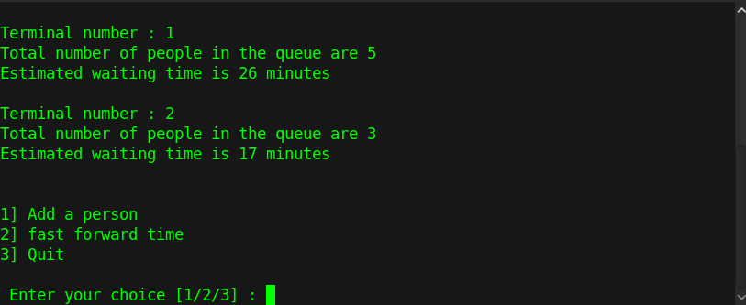
Assumptions made
We have assumed that there are no terminal failures and all terminals work properly
Demonstration
24/11/2019
1

Slide 5
Limitations/Constraints
There are no limitations as of now
Known defects in the solution
Terminals are not closed if there are no passengers

Slide 6
THANKS
24/11/2019
<number>

